Slide 1

CLOUDTHAT INTERNSHIP PROJECT
NAME - DEBJIT PAUL
STREAM - DSBA
ROLL - PG24091
COLLEGE - ISBR BUSINESS SCHOOL
BATCH - 24 -26

Slide 2



TOPIC
URBAN LOGISTICS PERFORMANCE AND PREDICTION DASHBOARD

Slide 3
PROJECT DESCRIPTION
• Monitor and compare delivery performance across cities, regions, and shifts
• Identify high-delay areas and underperforming couriers
• Optimize delivery routes by analyzing travel times and idle periods
• Predict delivery delays or failures based on operational and location-based features

Slide 4
THE DATA ANALYSIS PROCESS
Data Collection
Cleaning
Datasets Merged
We combined multiple related datasets to create the merged_orders_customers master table:
Orders dataset → Containing purchase, approval, and delivery timestamps for each order.
Customers dataset → Adding customer location details (city, state, zip).
Standardized date formats – All date columns (e.g., order_purchase_timestamp, order_approved_at) were converted to a consistent DateTime format to avoid mismatches in calculations.
Removed null and duplicate entries – Orders with missing customer IDs or order dates were cleaned out to ensure accurate aggregations.
Fixed data type mismatches – Numeric columns like delivery_duration_days were converted from text (string) to number so we can calculate averages and trends.
Standardized location names – City and state names were cleaned to remove spelling inconsistencies and extra spaces for better grouping.

Slide 5


TOOLS USED IN DATA ANALYSIS
PYTHON - Descriptive Analytics & Visualization and Predictive modelling.
SQL - SQL queries to identify bottleneck regions, vehicles with high idle time, top couriers. . Aggregate performance by day-of-week, city, or route clusters.
POWERBI - Interactive SCM Dashboard . Filters: City, region, courier, Visual elements: ▪ Line charts (weekly deliveries, delays) ▪ Heatmaps (geospatial delay density) ▪ Bar charts (courier performance, route load) ▪ KPIs (On-time %, avg. duration, idle time)

Slide 6
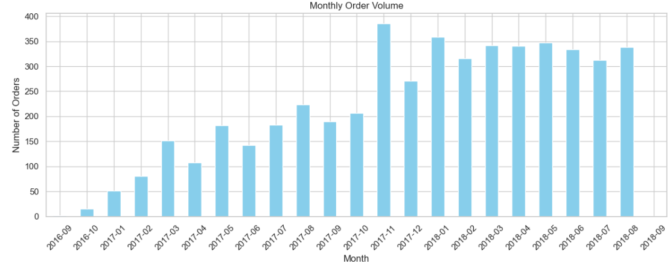
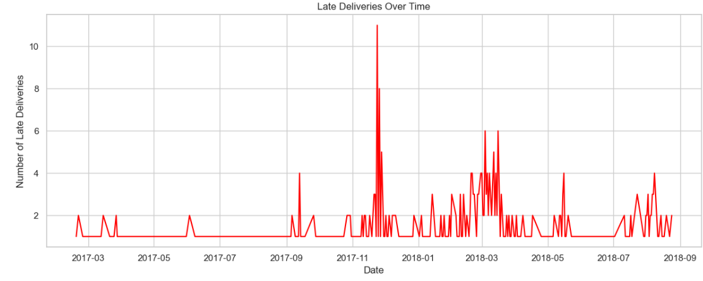
DATA VISUALIZATION
The graph is a bar chart that shows the number of orders per month. The x-axis represents the months of the year, starting from September 2016 and ending in August 2018. The y-axis shows the number of orders.
The main trend is that the number of orders was very low in late 2016 and early 2017.
Orders began to pick up significantly around mid-2017 and reached their highest point in late 2017 and early 2018. The graph ends with a slight drop in the number of orders in August 2018.
The peak in orders suggests a highly successful period for the business. This could be due to a holiday season (like Black Friday or Christmas) or a major marketing campaign.
The slight dip at the end might indicate a seasonal slowdown or the data collection simply stopping at that point, which is important to consider.

Slide 7
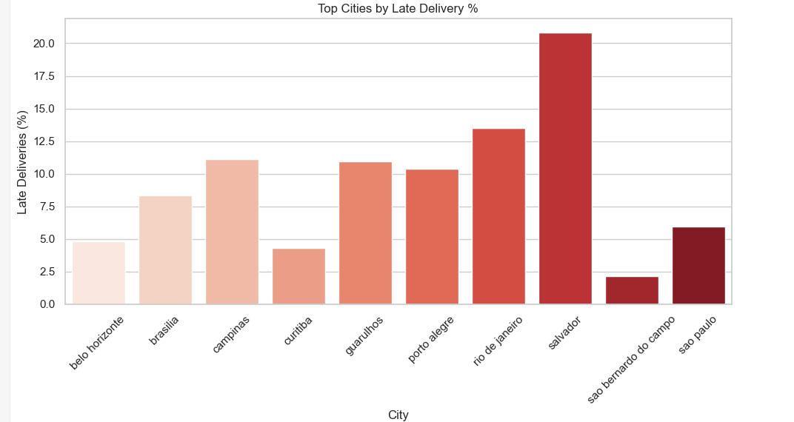
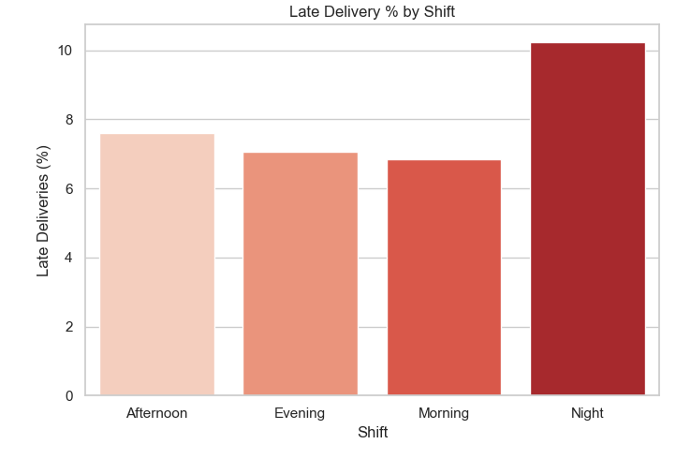
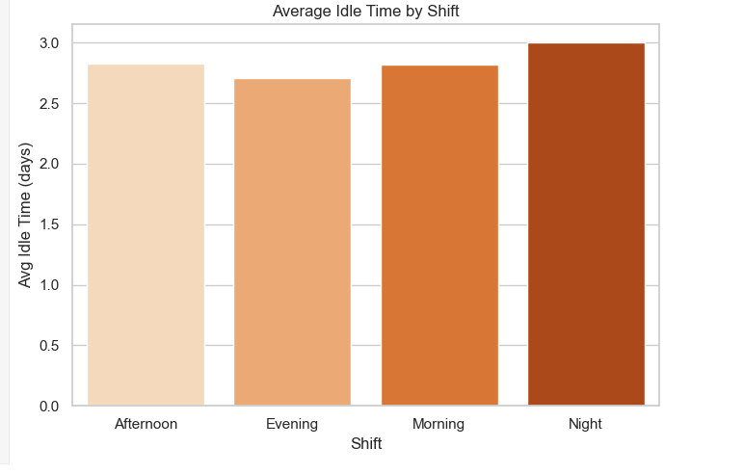

Slide 8
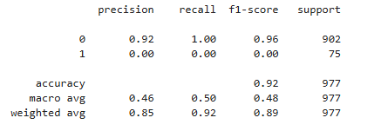
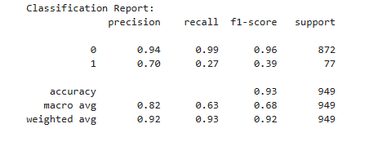
PREDICTIVE MODELLING
RANDOM FORREST MODEL
🏆 INTERPRETATION:
RANDOM FOREST often performs best, especially on imbalanced data.
Random Forest is strong and interpretable IN
this use case.
Logistic Regression failed to capture the minority class.
SVM and KNN are less effective in this use case.

Slide 9

The Simple Analogy
Imagine you're a delivery inspector trying to catch packages that are late.
Precision is how accurate you are when you say a package is late.
Example: You say 10 packages are late, and 7 of them actually are. Your precision is 7/10, or 70%.
Recall is how many of the actual late packages you manage to find.
Example: There are 100 late packages in total, and you find 27 of them. Your recall is 27/100, or 27%.
F1-Score is a single score that combines both precision and recall. It's a way to measure your overall effectiveness. A high F1-score means you're good at both accurately identifying late packages and finding most of them.

Slide 10
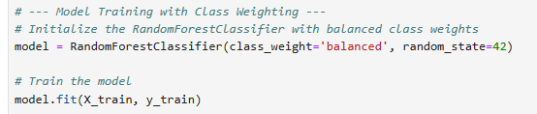
ANALYSIS
The code successfully trains a random forest model, and the classification_report shows the performance for both classes:
On-time delivery (0): the model is highly accurate for on-time deliveries, with a precision of 0.94 and a recall of 0.99. this means it rarely misclassifies an on-time delivery.
Late delivery (1): the model's performance for late deliveries has improved compared to previous attempts. the precision is 0.70, and the recall is 0.27. this is a significant improvement over the 0.03 recall from the logistic regression model.
The use of class_weight='balanced' in the randomforestclassifier is the key to this improvement. it forces the model to pay more attention to the minority class (late deliveries), leading to a better ability to identify them.

Slide 11
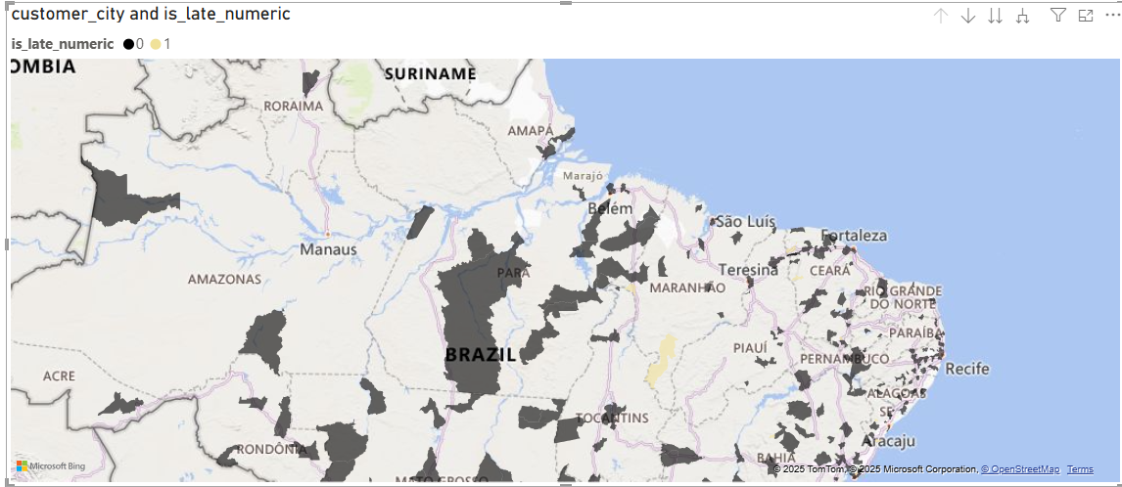
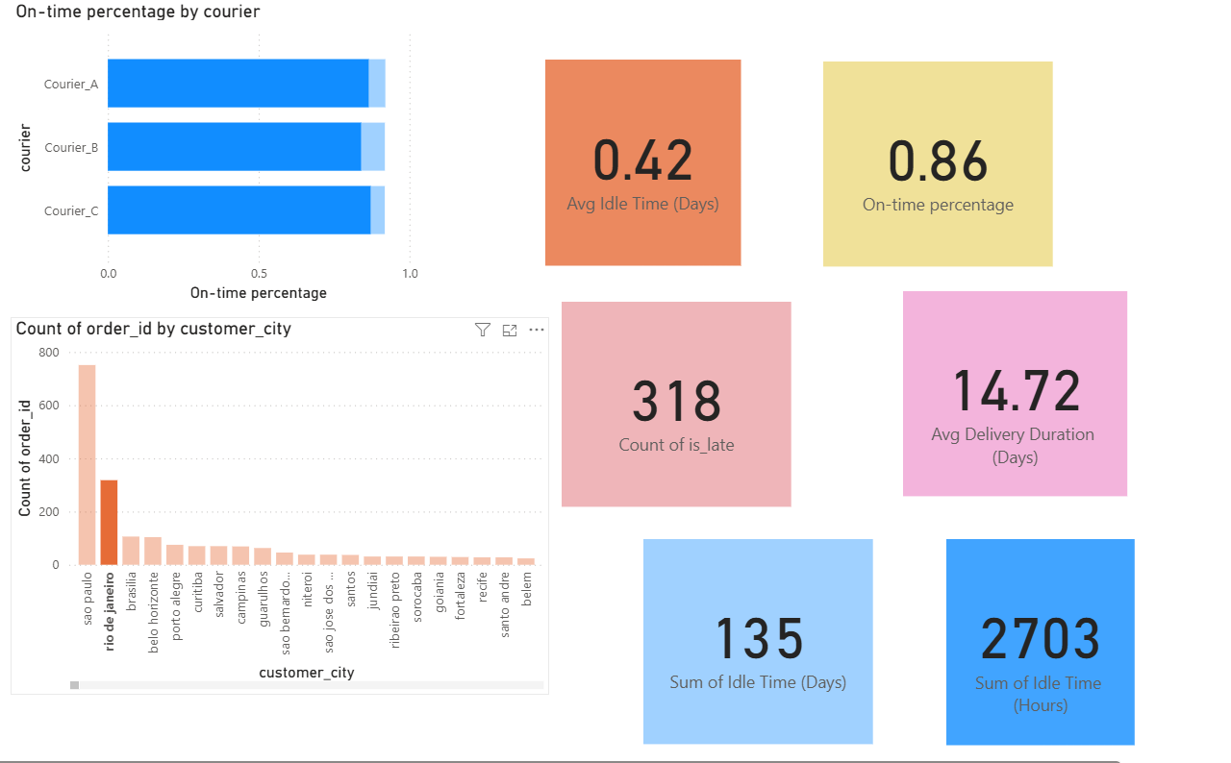

Slide 12
SUMMARY & RECOMMENDATIONS
Merged multiple datasets: orders, customers.
Cleaned and formatted data — fixed missing values, corrected dates, and standardized numbers.
Created new KPIs: average delivery time, on-time %, and idle time.
Built an interactive Power BI dashboard with city, region, courier, and delivery type filters.
Insights show bottleneck regions, top couriers, and delay patterns.
Recommendations: track shipment date, set delay alerts, and use AI for weekly summaries and predictions.

Slide 13
THANK YOU

